Slide 1
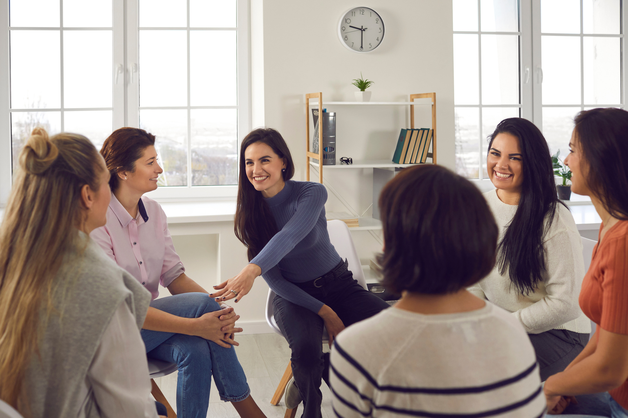

Mentorship Mixer

Slide 2
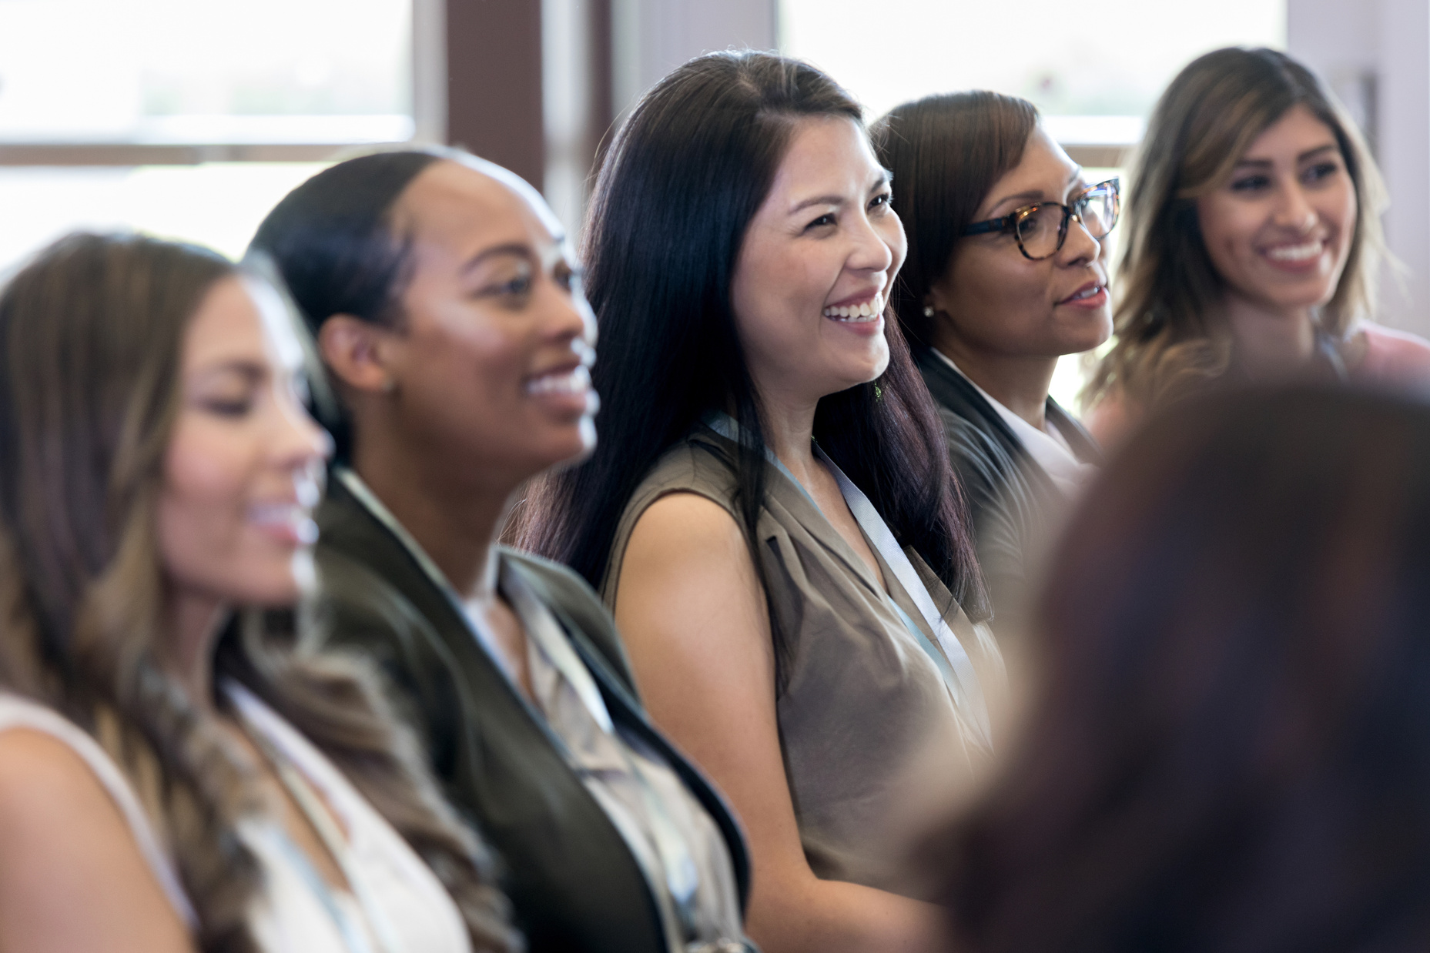
Purpose of the event
Our event empowers women by providing structured networking opportunities and personalized mentorship sessions to enhance their careers and personal growth.

Slide 3

Keynote speaker
Our keynote speaker will share her inspiring story of perseverance and success. You'll leave feeling motivated and empowered to achieve your goals.

Slide 4
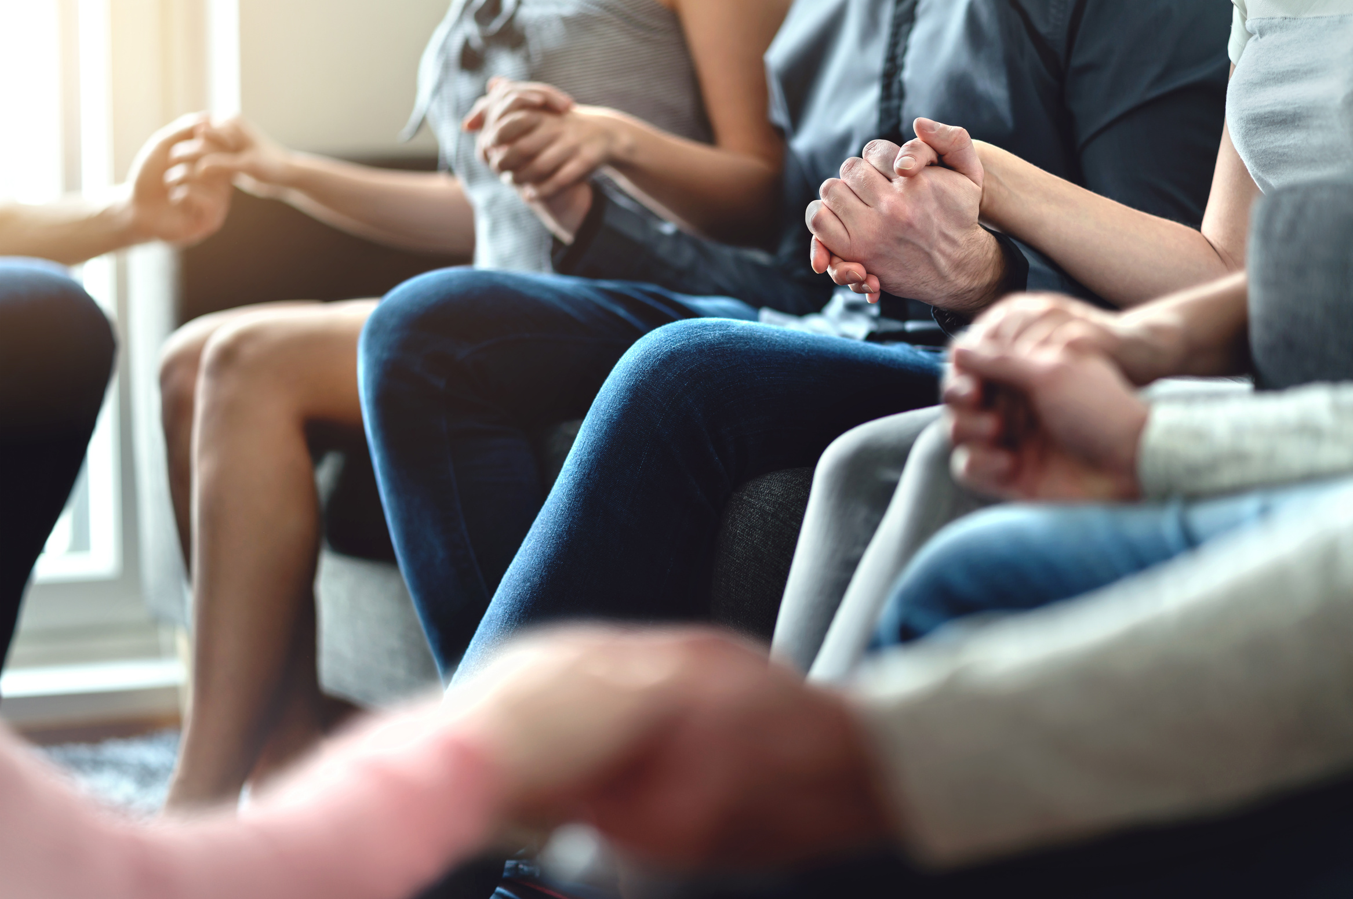
Structured networking
Join us for an empowering event designed to connect women professionals. Enjoy structured networking and 1:1 mentorship sessions. Don't miss out!

Slide 5
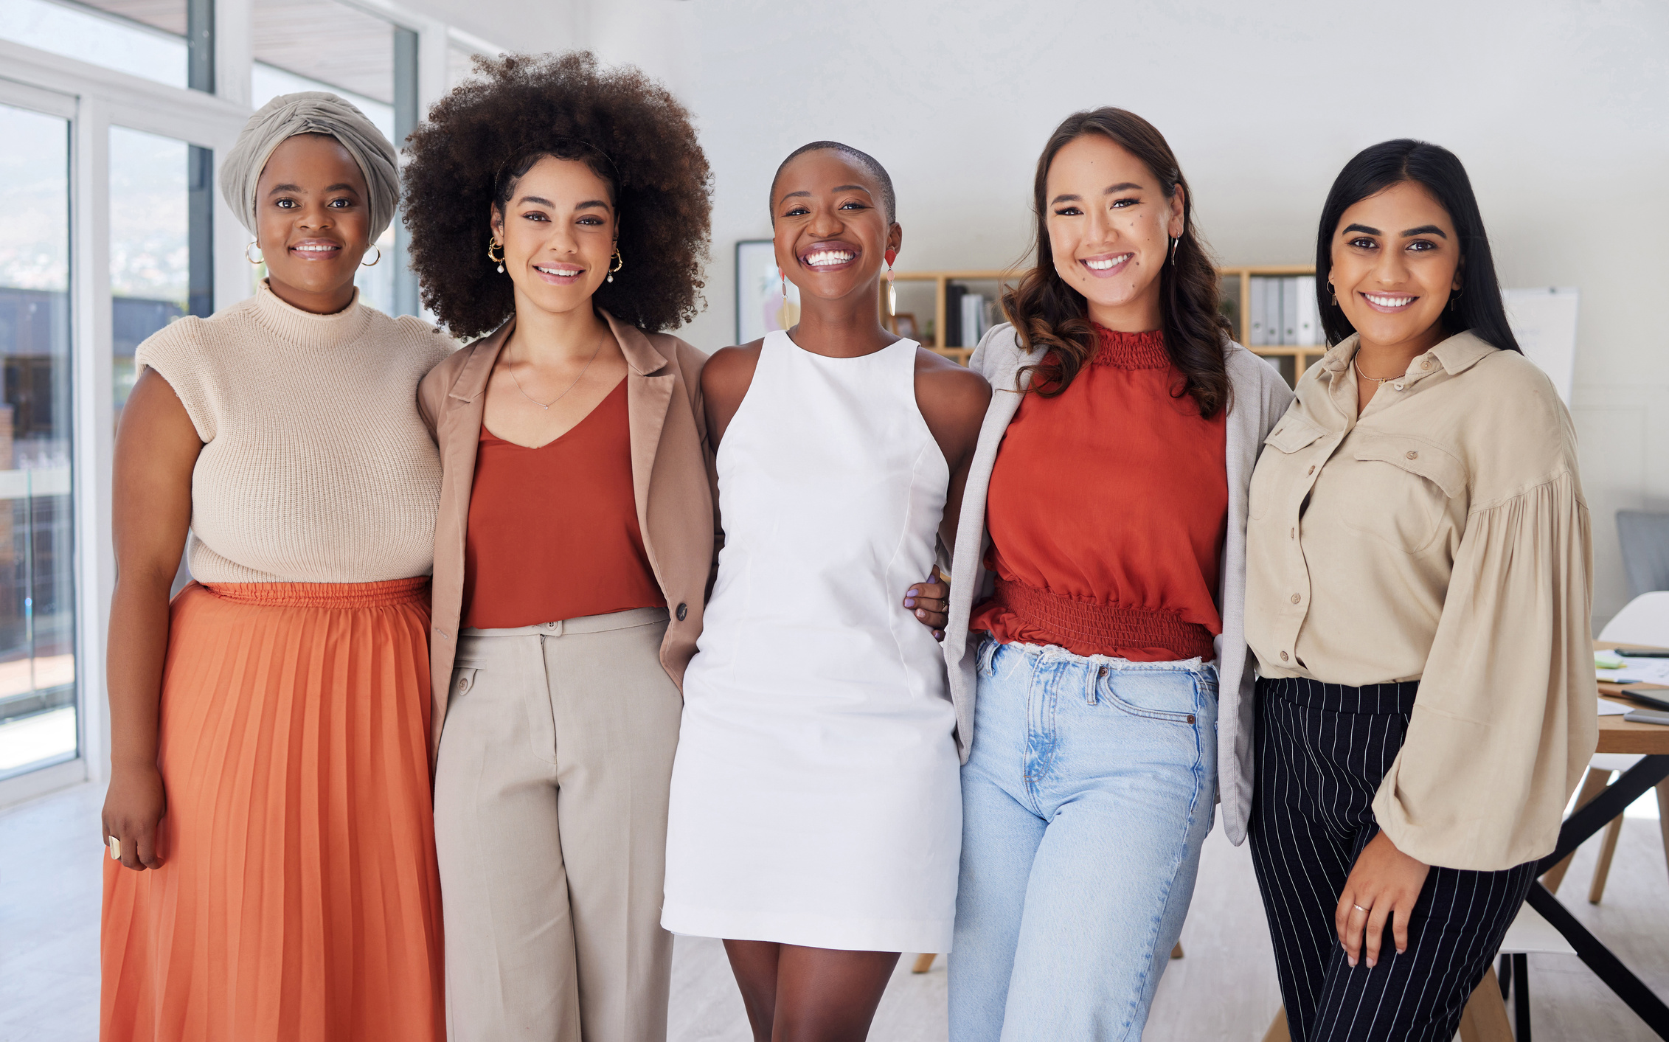
Mentorship sessions
Join us for a day of empowering women through structured networking, mentorship sessions, and small group discussions with industry leaders.

Slide 6
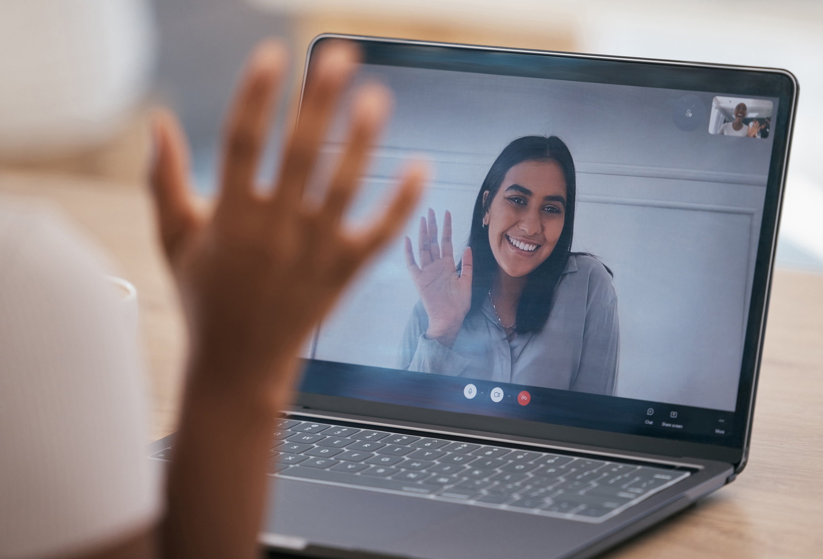
How to get involved

Slide 7
THANK YOU FOR JOINING US TODAY AND INVESTING IN YOURSELF AND YOUR COMMUNITY. WE HOPE YOU LEAVE FEELING EMPOWERED AND CONNECTED!

